Slide 1
Sexual and Reproductive Anatomy
5th Grade SHARE

Slide 2
BODY PARTS…
Can you name a body part that almost everyone has?

Slide 3
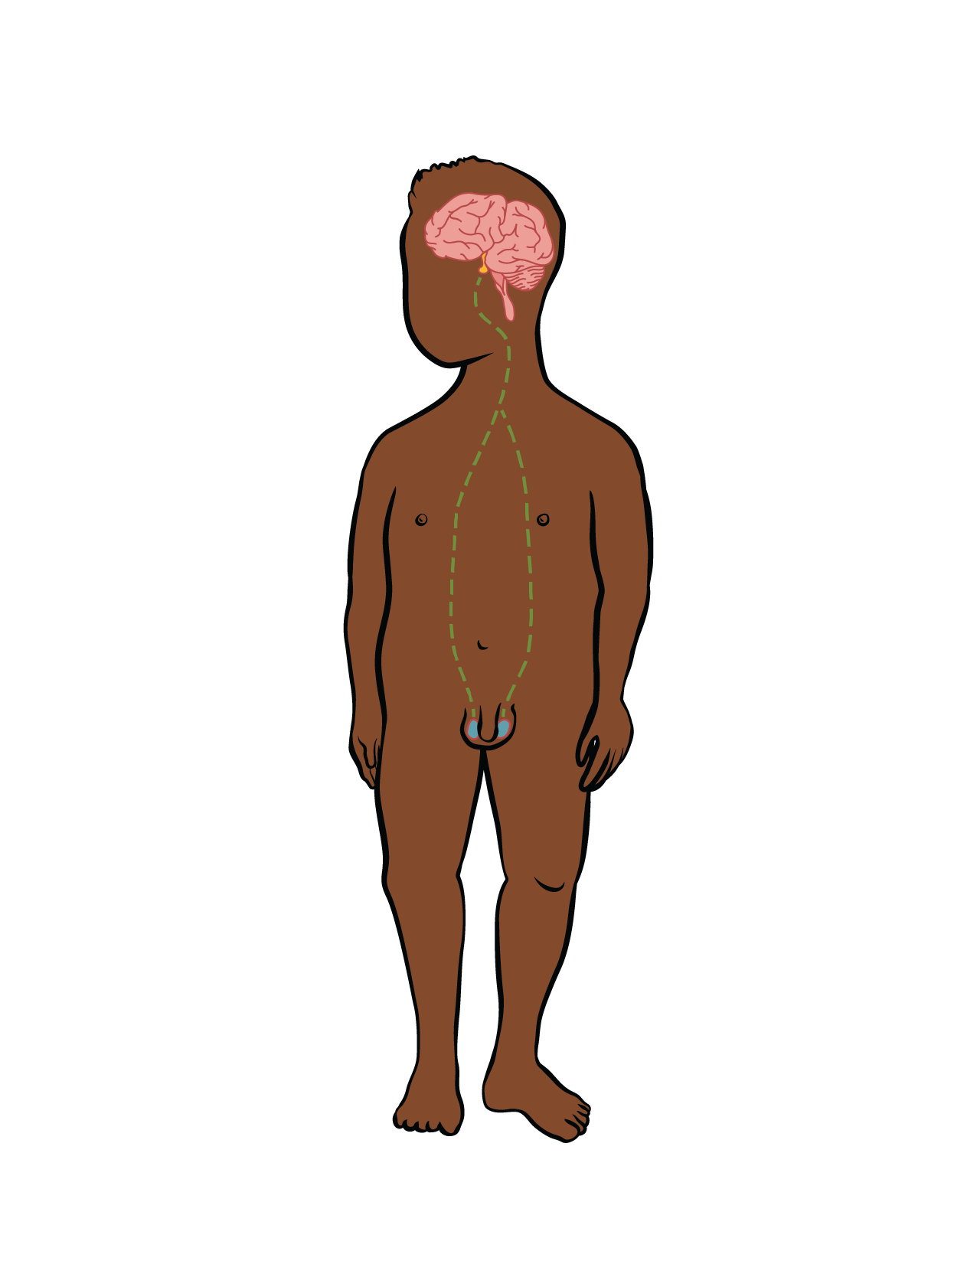
Pituitary Gland
The pituitary gland is very small — only about the size of a pea!
Its job is to produce and release hormones into your body.

Slide 4
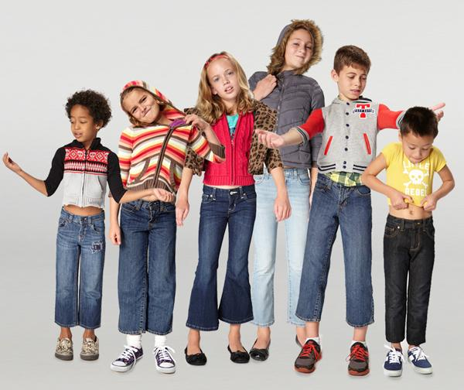
If your clothes from last year are too small, it's because your pituitary gland released special hormones that made you grow.

Slide 5

Anatomy: Male

Slide 6
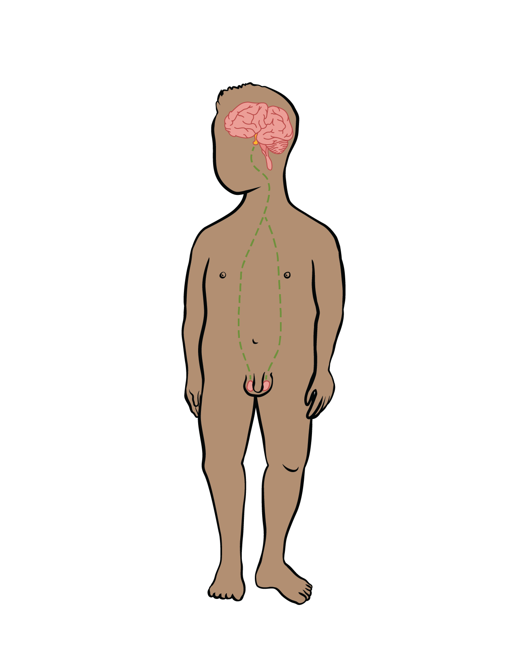
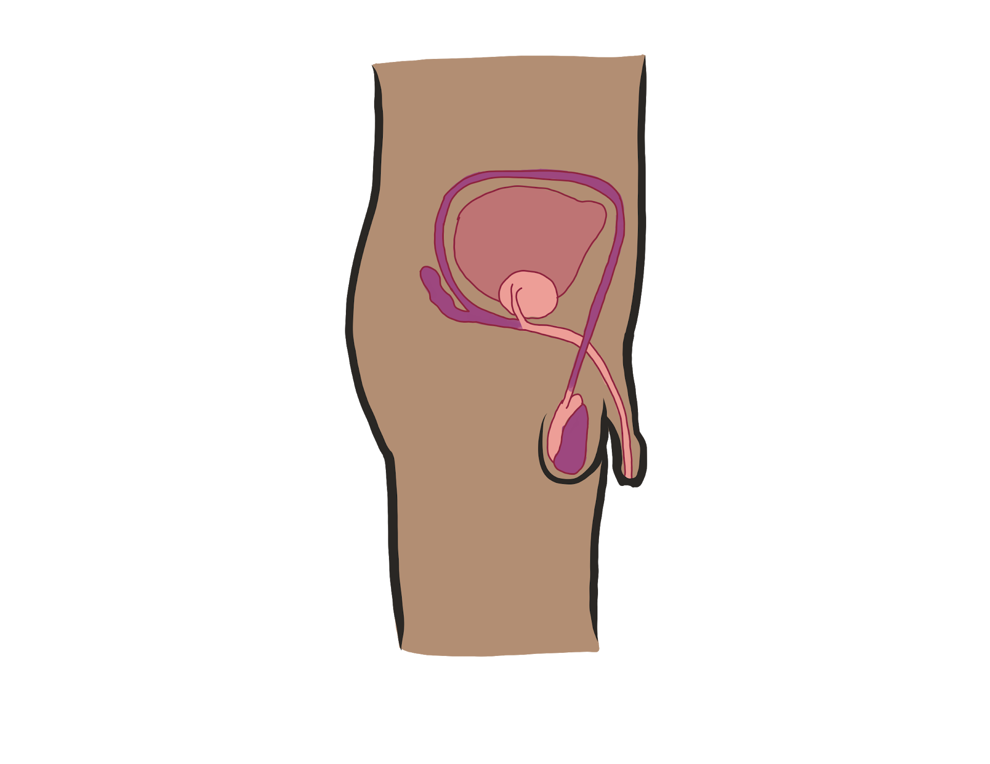
Reproductive System One

Slide 7
System One:
Boy and Body with a Penis
Bladder
[Semen is made here!]
Penis
Urethra
Testicle
[Sperm are made here!]
Scrotum
Illustrations by Jess Worby
Notes:
Bummed that this visual doesn’t include the prostate, but I really like it otherwise (was designed by someone at the NYC DoE). Any chance we could add one in?

Slide 8
Anatomy: Female

Slide 9
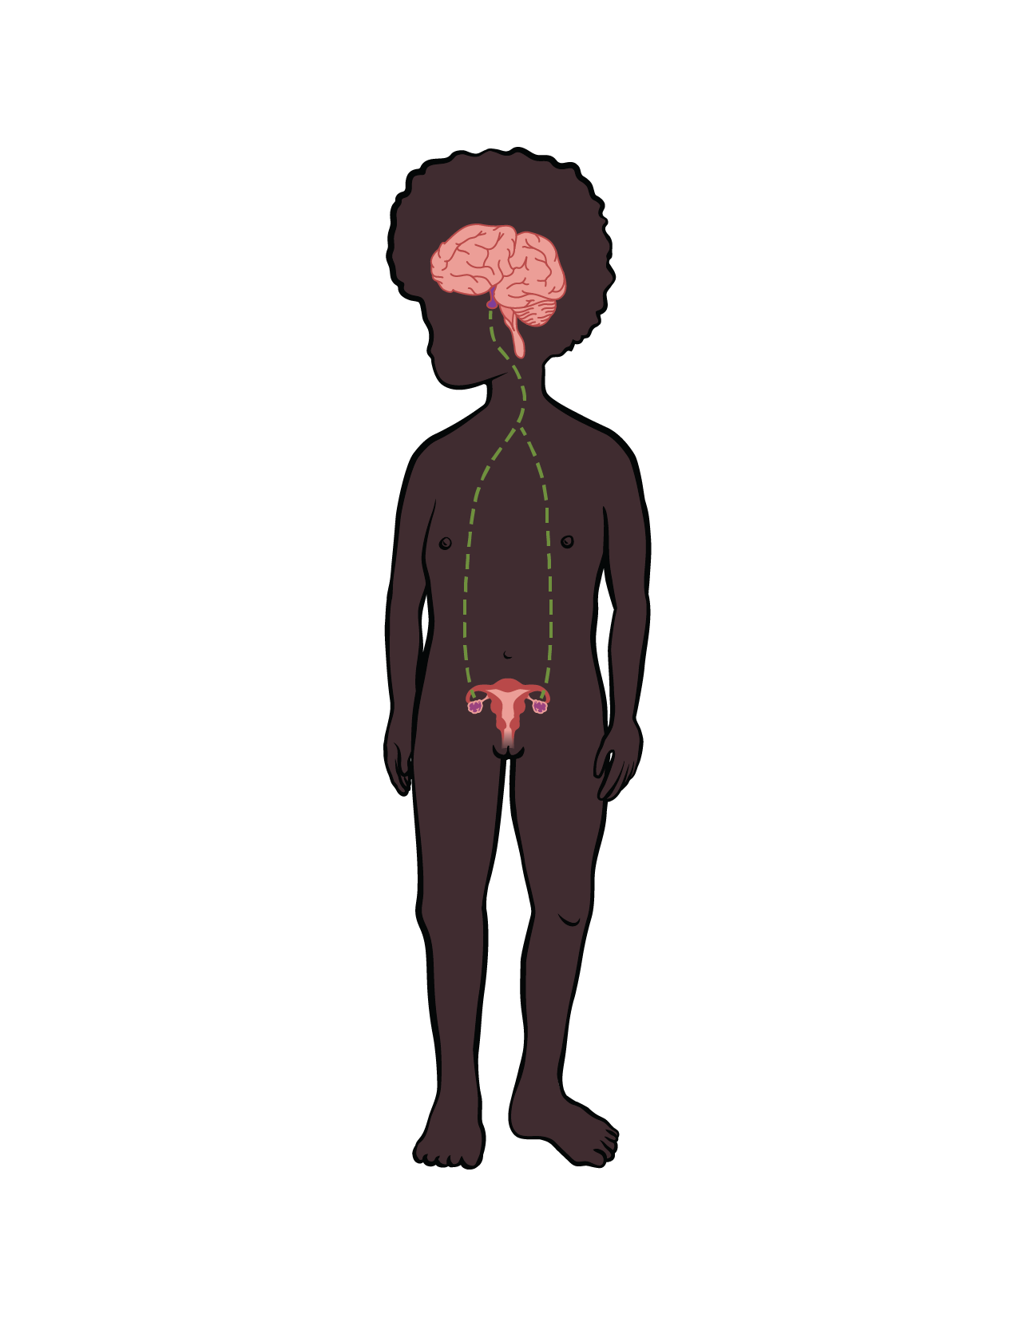
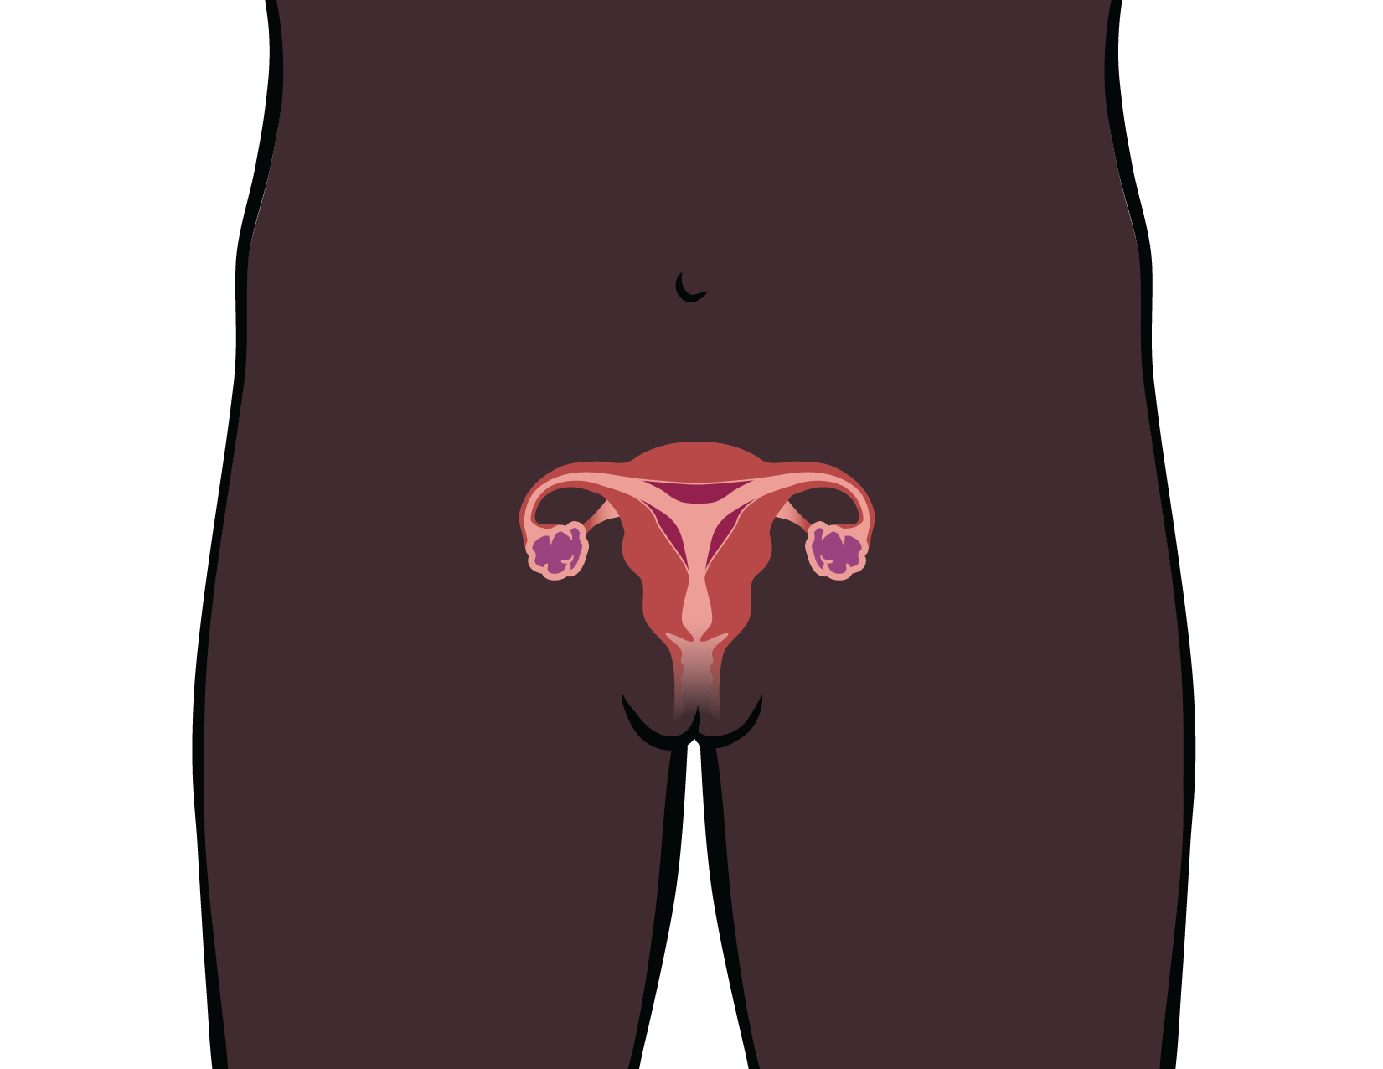
Reproductive System Two

Slide 10
System Two: Girl and Body with a
Vulva
Uterus
Fallopian Tube
Fallopian Tube
Ovary
Ovary
Cervix
Vagina
Vulva
Illustrations by Jess Worby

Slide 11
Body with a Vulva
Clitoris
Urethral opening
Outer labia
Vaginal opening
Inner labia
Anus
Illustrations by Jess Worby
Slide 11

Slide 12
Remember, everybody is unique, no individual is exactly like another. That also includes their body parts (including their sexual and reproductive organs and systems) everybody’s parts are unique to them.

Slide 13
If you have More questions about what is or isn’t happening to your body, who could you ask?
Parent or Guardian
Trusted adult
School Counselor
School Nurse
Teacher
Faith based leader
Health Clinic
Health care provider

Slide 14
NOT Reliable Sources of information:
Friends
Siblings
Internet
Social media
TV

Slide 15
Closing Game

